Slide 1
Automata Learning for Symbolic Execution

Slide 2
Reminder
Software model checking is systematic testing

Slide 3
Reminder
Software model checking is systematic testing
applicable to industrial size software

Slide 4



Testing & Verification Approaches
Static Analysis
Verification
Symbolic Execution
Extended Static Analysis
Confidence
Concolic Execution
& White-box Fuzzing
Ad-hoc testing
Cost (programmer effort, time, expertise)

Slide 5
Testing vs. Model Checking ^{(revisited)}
Testing
Systematic Exhaustive Search
Coverage Guarantees
Low Cost
Low Confidence
Model Checking
Systematic Exhaustive Search
Coverage Guarantees
High Cost
High Confidence
Given the source code, how can we create a low cost, high confidence systematic search of software’s state-space?

Slide 6
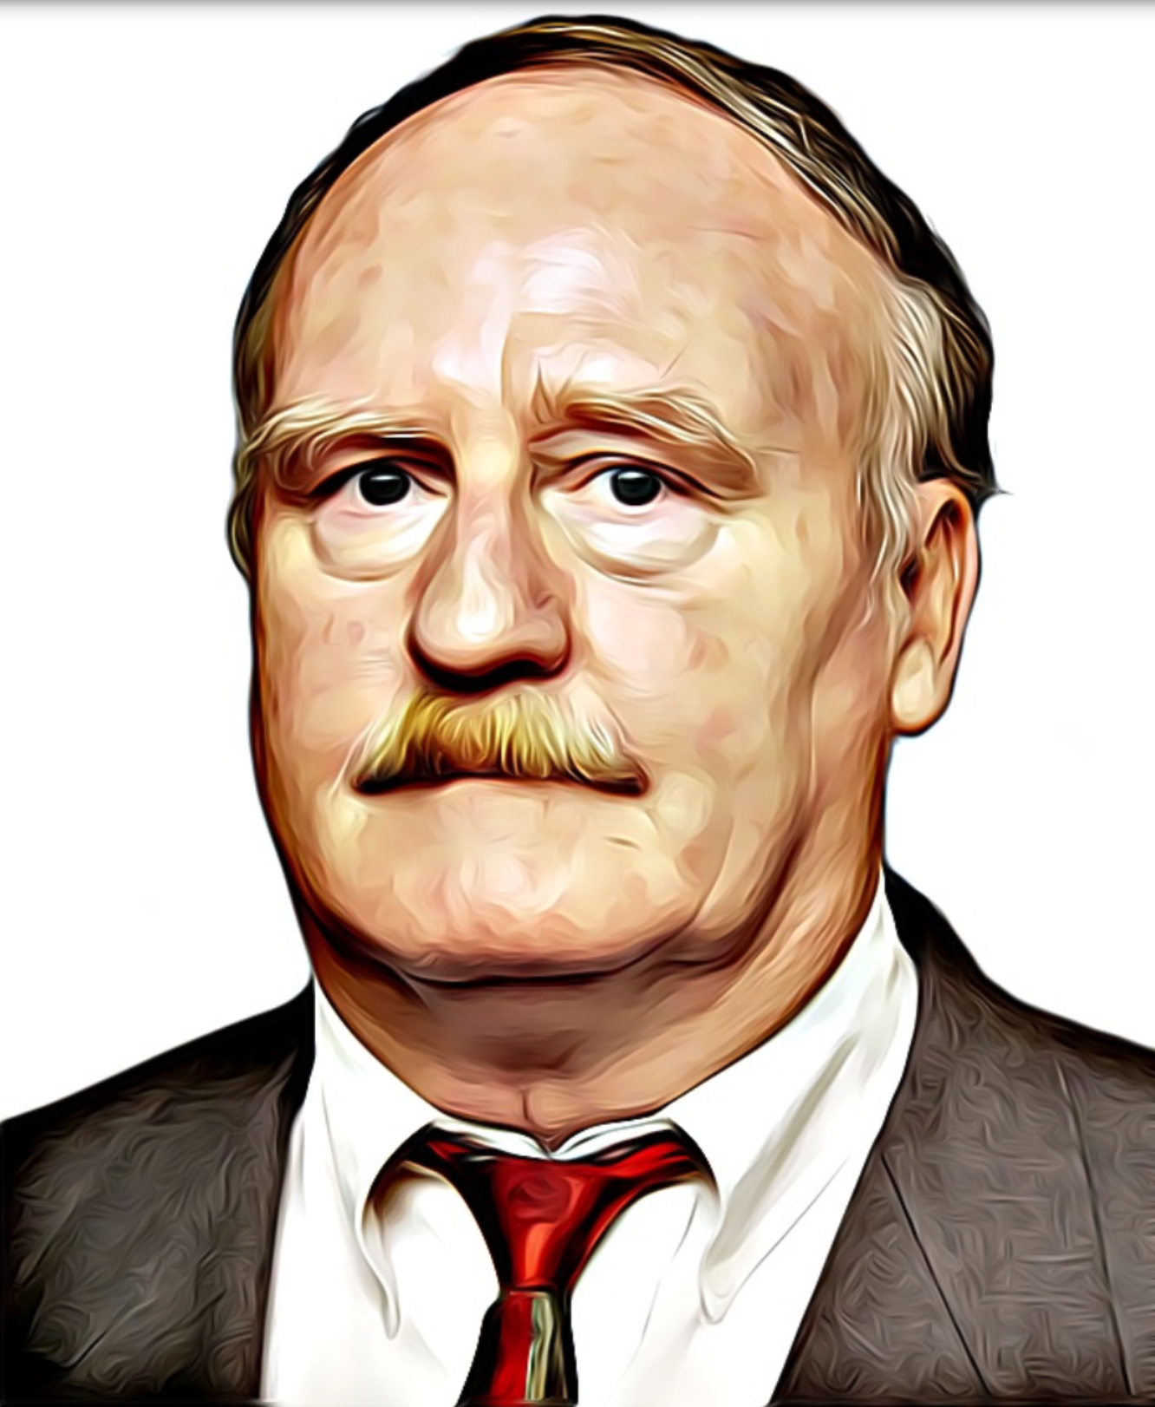

Symbolic Execution ^{(History)}

Slide 7
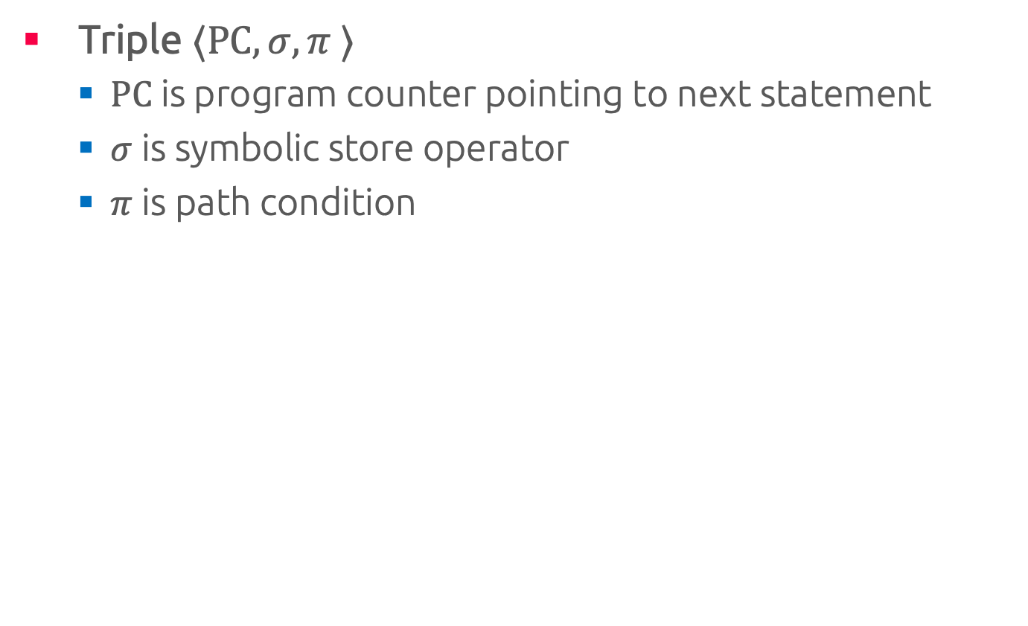
Symbolic State
Triple $⟨PC,σ,π ⟩$
PC is program counter pointing to next statement
$σ$ is symbolic store operator
$π$ is path condition

Slide 8
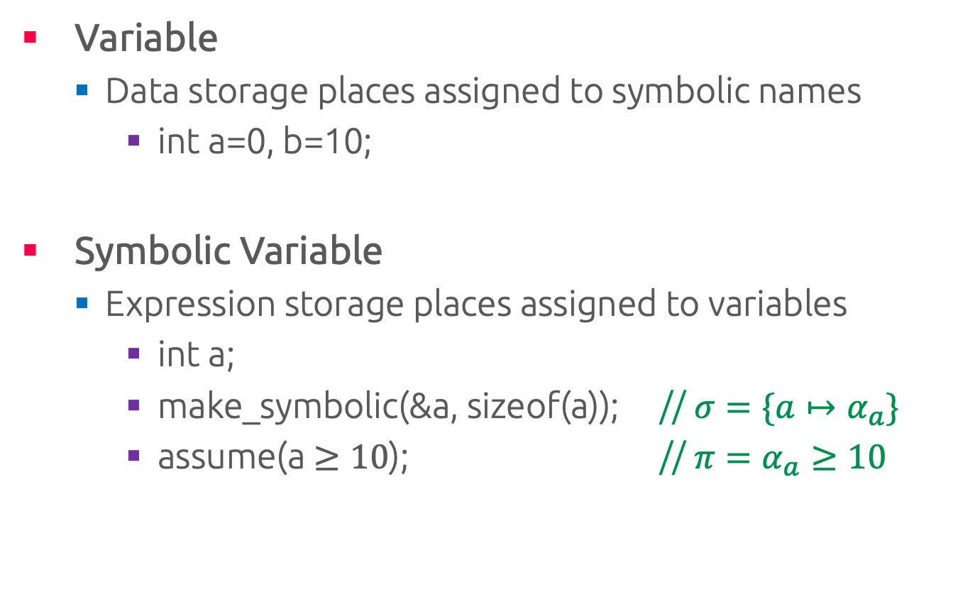
Variable & Symbolic Variable
Variable
Data storage places assigned to symbolic names
int a=0, b=10;
Symbolic Variable
Expression storage places assigned to variables
int a;
make_symbolic(&a, sizeof(a)); // $σ=\{a↦α_{a}\}$
assume(a $≥10$); // $π=α_{a}≥10$

Slide 9
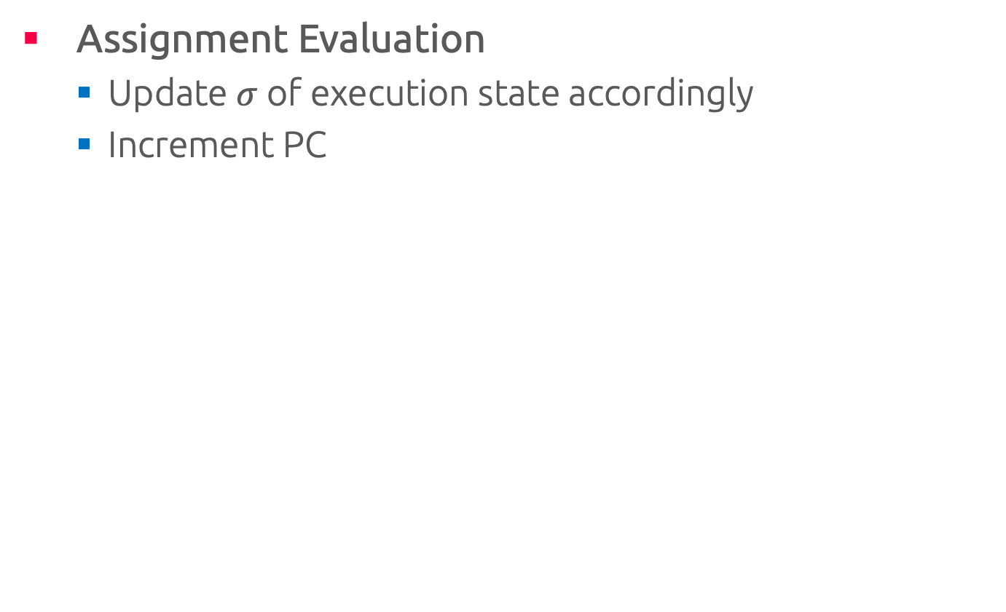
Assignments
Assignment Evaluation
Update $σ$ of execution state accordingly
Increment PC

Slide 10
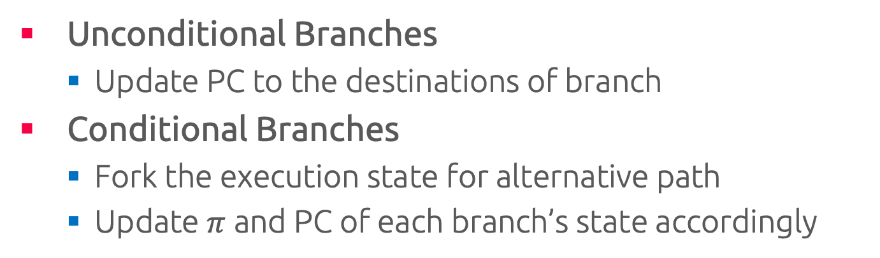
Branches
Unconditional Branches
Update PC to the destinations of branch
Conditional Branches
Fork the execution state for alternative path
Update $π$ and PC of each branch’s state accordingly

Slide 11
Symbolic Execution Tree

Slide 12
Example: Memory Model

Slide 13
Example: Fully Symbolic Memory Model

Slide 14
Exercise: Compute Symbolic Execution Tree
int main() {
int x,y;
scanf("%d", &x);
scanf("%d", &y);
int z = f(x, y);
if (z == 978121)
assert(false && "OK");
else
assert(false && “NO");
return 0;}
int f(int a, b){
n = a*a+b*b;
d = a*b+1;
return (int)(n/d);}

Slide 15
Automata Learning for Symbolic Execution

Slide 16
Motivation: Petit FAT File System
Symbolic Execution of File System & Disk Controller?
What if disk content triggers a bug in the File System?
What if a malicious SD-Card controller knows this bug?
Software
Testing
Petit FatFs
SDC Controller
Test Cases
Learn
Petit FatFs
FSM
Symbolic Execution

Slide 17
Motivation: Petit FAT File System ^{contd.}
Petit Fat File System
Lightweight
Popular
Poorly tested
unsigned char
fs->csize = buf[BPB_SecPerClus-13]; /* Number of sectors per cluster */
fs->n_rootdir = LD_WORD(buf+BPB_RootEntCnt-13); /* Nmuber of root directory entries */
tsect = LD_WORD(buf+BPB_TotSec16-13); /* Number of sectors on the file system */
if (!tsect) tsect = LD_DWORD(buf+BPB_TotSec32-13);
mclst = (tsect /* Last cluster# + 1 */
- LD_WORD(buf+BPB_RsvdSecCnt-13) - fsize - fs->n_rootdir / 16
) / fs->csize + 2;
fs->n_fatent = (CLUST)mclst;
Potential Overflow!
Actual code-snippet from PetitFatFile System Module (Release date June 10, 2014)

Slide 18
Motivation: Petit FAT File System ^{contd.}
Petit Fat File System
Lightweight
Popular
Poorly tested
unsigned char
fs->csize = buf[BPB_SecPerClus-13]; /* Number of sectors per cluster */
fs->n_rootdir = LD_WORD(buf+BPB_RootEntCnt-13); /* Nmuber of root directory entries */
tsect = LD_WORD(buf+BPB_TotSec16-13); /* Number of sectors on the file system */
if (!tsect) tsect = LD_DWORD(buf+BPB_TotSec32-13);
mclst = (tsect /* Last cluster# + 1 */
- LD_WORD(buf+BPB_RsvdSecCnt-13) - fsize - fs->n_rootdir / 16
) / fs->csize + 2;
fs->n_fatent = (CLUST)mclst;
Potential Div by Zero!
Actual code-snippet from PetitFatFile System Module (Release date June 10, 2014)

Slide 19

Motivation
Petit FAT FS calls black-box SD-Card controller
Cannot combine Symbolic Execution & black-boxes
impossible to form path constraints
Manual modeling: error-prone, labor intensive
Concolic execution is ineffective
Petit FAT File System

Slide 20
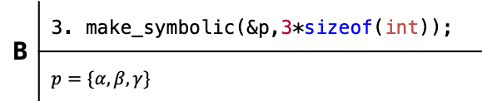
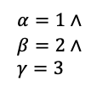
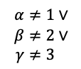
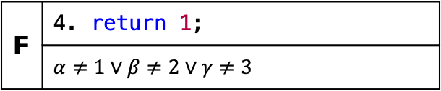
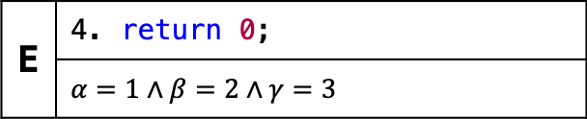
Concolic Execution
6 int check(int* p) {
7 return(p[0]==1&&p[1]==2&&p[2]==3)
8 }
1 int padlock(void) {
2 int p[3];
3 p = make_symbolic();
4 if( check(p) ) {…} else {…};
5 }
A | 2. int p[3];
B | 3. make_symbolic(&p,3*sizeof(int));
 | $$p=\{α, β, γ\}$$
C | 7. return(p[0]==1&&p[1]==2&&p[2]==3)
$$α=1∧ \\ β=2∧ \\ γ=3$$
$$α≠1∨ \\ β≠2∨ \\ γ≠3$$
D | 4. if( check(p) )
E | 4. return 0;
 | $$α=1∧β=2∧γ=3$$
F | 4. return 1;
 | $$α≠1∨β≠2∨γ≠3$$

Slide 21

Concolic Execution
int check(int p) {
static state = 0;
if(state==0 && p==1){state = 1; return 0;}
else if(state==1 && p==2){state = 2; return 0;}
else if(state==2 && p==3){state = 3; return 1;}
else{ state=0; return 0;}
}
1 int padlock(void) {
2 int p[3];
3 p = make_symbolic();
4 if( check(p) ) {…} else {…};
5 }
White-box: $O\left(m\right)=O\left(|Σ|\right)$ steps

Slide 22
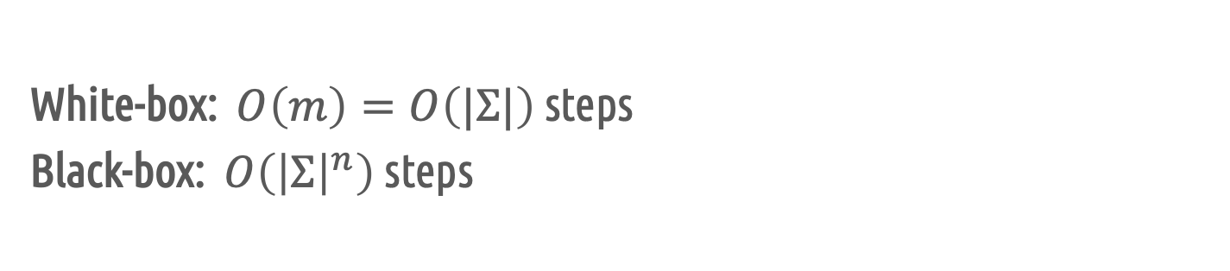
Concolic Execution
int check(int p) {
static state = 0;
if(state==0 && p==1){state = 1; return 0;}
else if(state==1 && p==2){state = 2; return 0;}
else if(state==2 && p==3){state = 3; return 1;}
else{ state=0; return 0;}
}
1 int padlock(void) {
2 int p[3];
3 p = make_symbolic();
4 if( check(p) ) {…} else {…};
5 }
White-box: $O\left(m\right)=O\left(|Σ|\right)$ steps
Black-box: $O\left({\left|Σ\right|}^{n}\right)$ steps
(Bounds are not quite right)

Slide 23

Learning enables symbolic execution for black-box automata

Slide 24
Automata Learning for Symbolic Execution
Software Under Test
White-box
Black-box
Copy
Learn
White-box
FSM
Learn black-box by automata learning.

Slide 25
Automata Learning for Symbolic Execution
Software Under Test
White-box
Black-box
Copy
Learn
Test Cases
White-box
FSM
Symbolic Execution
Learn black-box by automata learning.
Execute learned setup symbolically.

Slide 26
Automata Learning for Symbolic Execution
Software Under Test
Software Testing
White-box
Black-box
Copy
Learn
Test Cases
White-box
FSM
Symbolic Execution
Learn black-box by automata learning.
Execute learned setup symbolically.
Test software under test automatically.

Slide 27
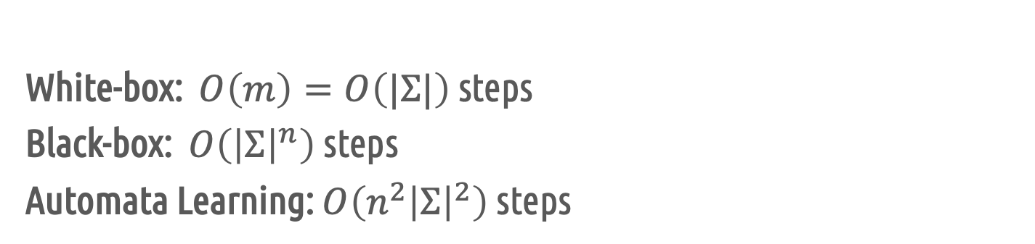
Concolic Execution
int check(int p) {
static state = 0;
if(state==0 && p==1){state = 1; return 0;}
else if(state==1 && p==2){state = 2; return 0;}
else if(state==2 && p==3){state = 3; return 1;}
else{ state=0; return 0;}
}
1 int padlock(void) {
2 int p[3];
3 p = make_symbolic();
4 if( check(p) ) {…} else {…};
5 }
White-box: $O\left(m\right)=O\left(|Σ|\right)$ steps
Black-box: $O\left({\left|Σ\right|}^{n}\right)$ steps
Automata Learning: $O\left({n^{2}\left|Σ\right|}^{2}\right)$ steps
(Bounds are not quite right)

Slide 28
Motivation: Petit FAT File System ^{revisited}
Problem
Control alphabet is too large
Disk content implies enormous state-space
Disk Content
Software Testing
Petit FatFs
SDC Controller
Disk Images
Learn
Petit FatFs
Mapper
Abstract FSM
Symbolic Execution

Slide 29
Mapper’s Role
White-box works with concrete alphabets
Automata works with abstract alphabets
Mapper knows about abstraction & concretization
Abstract Input
Concrete Input
Learning
Learner
Mapper
SUL
Abstract Output / CEX
Concrete Output / CEX
Howar 11, Aarts 15
Concrete Input
Abstraction
Symbolic Execution
White-box
Mapper
Abstract FSM
Concrete Output
Abstract
Output

Slide 30
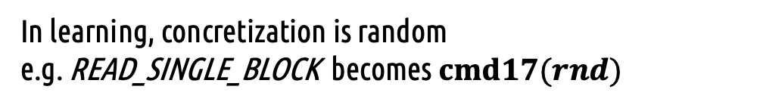
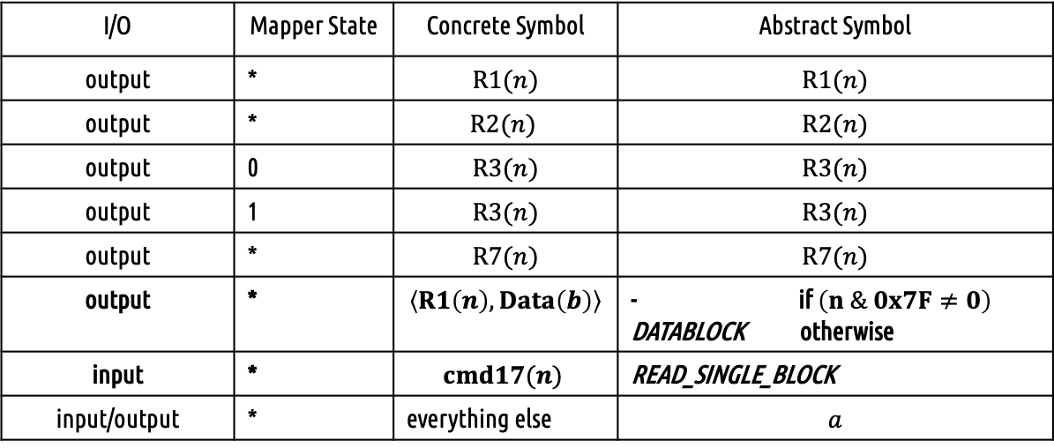
Mapper in Learning
Abstract Input
Concrete Input
Learner
Mapper
SDC Controller
Abstract
Output / CEX
Concrete
Output / CEX
I/O | Mapper State | Concrete Symbol | Abstract Symbol
output | * | $$R1(n)$$ | $$R1(n)$$
output | * | $$R2(n)$$ | $$R2(n)$$
output | 0 | $$R3(n)$$ | $$R3(n)$$
output | 1 | $$R3(n)$$ | $$R3(n)$$
output | * | $$R7(n)$$ | $$R7(n)$$
output | * | $$\left\langle R1\left(n\right), Data\left(b\right)\right\rangle$$ | - if$\left(n \& 0x7F≠0\right)$ DATABLOCK otherwise
input | * | $$cmd17(n)$$ | READ_SINGLE_BLOCK
input/output | * | everything else | $$a$$
In learning, concretization is random e.g. READ_SINGLE_BLOCK becomes $cmd17(rnd)$

Slide 31
Mapper is Symbolic Execution
Concrete Input
Abstract Input
PetitFFS
Mapper
Abstract Controller
Concrete Output
Abstract Output
I/O | Mapper State | Concrete Symbol | Abstract Symbol
output | * | $$R1(n)$$ | $$R1(n)$$
output | * | $$R2(n)$$ | $$R2(n)$$
output | 0 | $$R3(n)$$ | $$R3(n)$$
output | 1 | $$R3(n)$$ | $$R3(n)$$
output | * | $$R7(n)$$ | $$R7(n)$$
output | * | $$\left\langle R1\left(n\right), Data\left(b\right)\right\rangle$$ | - if$\left(n \& 0x7F≠0\right)$ DATABLOCK otherwise
input | * | $$cmd17(n)$$ | READ_SINGLE_BLOCK
input/output | * | everything else | $$a$$
How do we concretize during execution?
DATA_BLOCK becomes ???

Slide 32
Mapper is Symbolic Execution
Concrete Input
Abstract Input
PetitFFS
Mapper
Abstract Controller
Concrete Symbolic Output
Abstract Output
I/O | Mapper State | Concrete Symbol | Abstract Symbol
output | * | $$R1(n)$$ | $$R1(n)$$
output | * | $$R2(n)$$ | $$R2(n)$$
output | 0 | $$R3(n)$$ | $$R3(n)$$
output | 1 | $$R3(n)$$ | $$R3(n)$$
output | * | $$R7(n)$$ | $$R7(n)$$
output | * | $$\left\langle R1\left(n\right), Data\left(b\right)\right\rangle$$ | - if$\left(n \& 0x7F≠0\right)$ DATABLOCK otherwise
input | * | $$cmd17(n)$$ | READ_SINGLE_BLOCK
input/output | * | everything else | $$a$$
Allow Symbolic Execution to instantiate disk data as desired!
How do we concretize during execution?
DATA_BLOCK becomes ???

Slide 33
Petit FAT File System: Learning
SD-Card Controller | Size | Abstract Inputs | Abstract Outputs | States | Transitions | Clock Time
Certgate SDC | 512 MB | 9 | 23 | 39 | 351 | <3h
Kingston SDC | 2 GB | 9 | 51 | 68 | 612 | ~3h
Kingston SDHC | 4 GB | 9 | 44 | 41 | 369 | <3h
Size of abstract alphabet: symbols actually observed

Slide 34
Petit FAT File System: Testing
Testing Method | Statement Coverage |  | Clock Time | Disk Images
 | Test Scenario | PFF
Concolic Execution | 28.57% | 8.53% | 24h | 1
L* + Symbolic Execution | 100.0% | 83.89% | 24h | 19
Testing Scenario: Mount partition; Open a file; Test content against predefined values

